Slide 1
Structure From Motion
Chul Min Yeum
Assistant Professor
Civil and Environmental Engineering
University of Waterloo, Canada
CIVE 497 – CIVE 700: Smart Structure Technology
Last updated: 2019-03-14

Slide 2
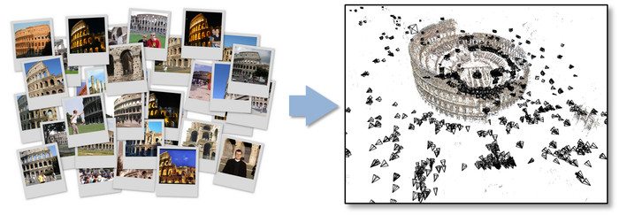
What is Structure from Motion (SfM) ?
Pictures
Scene structure & camera locations and parameters
http://www.cs.cornell.edu/projects/bigsfm/

Slide 3
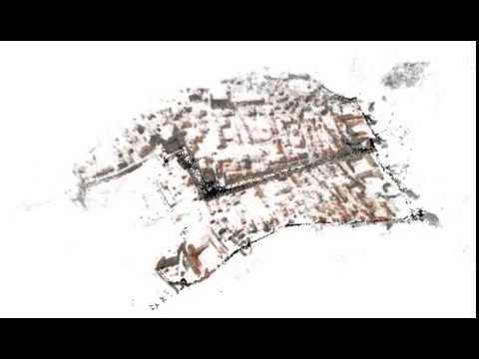
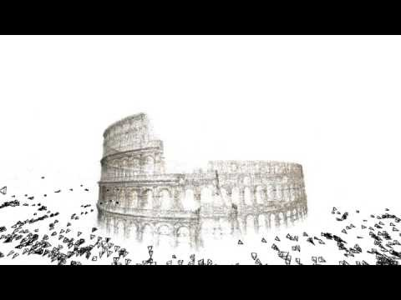
Example: BigSfM - Reconstructing the World from Internet Photos
http://www.cs.cornell.edu/projects/bigsfm/

Slide 4
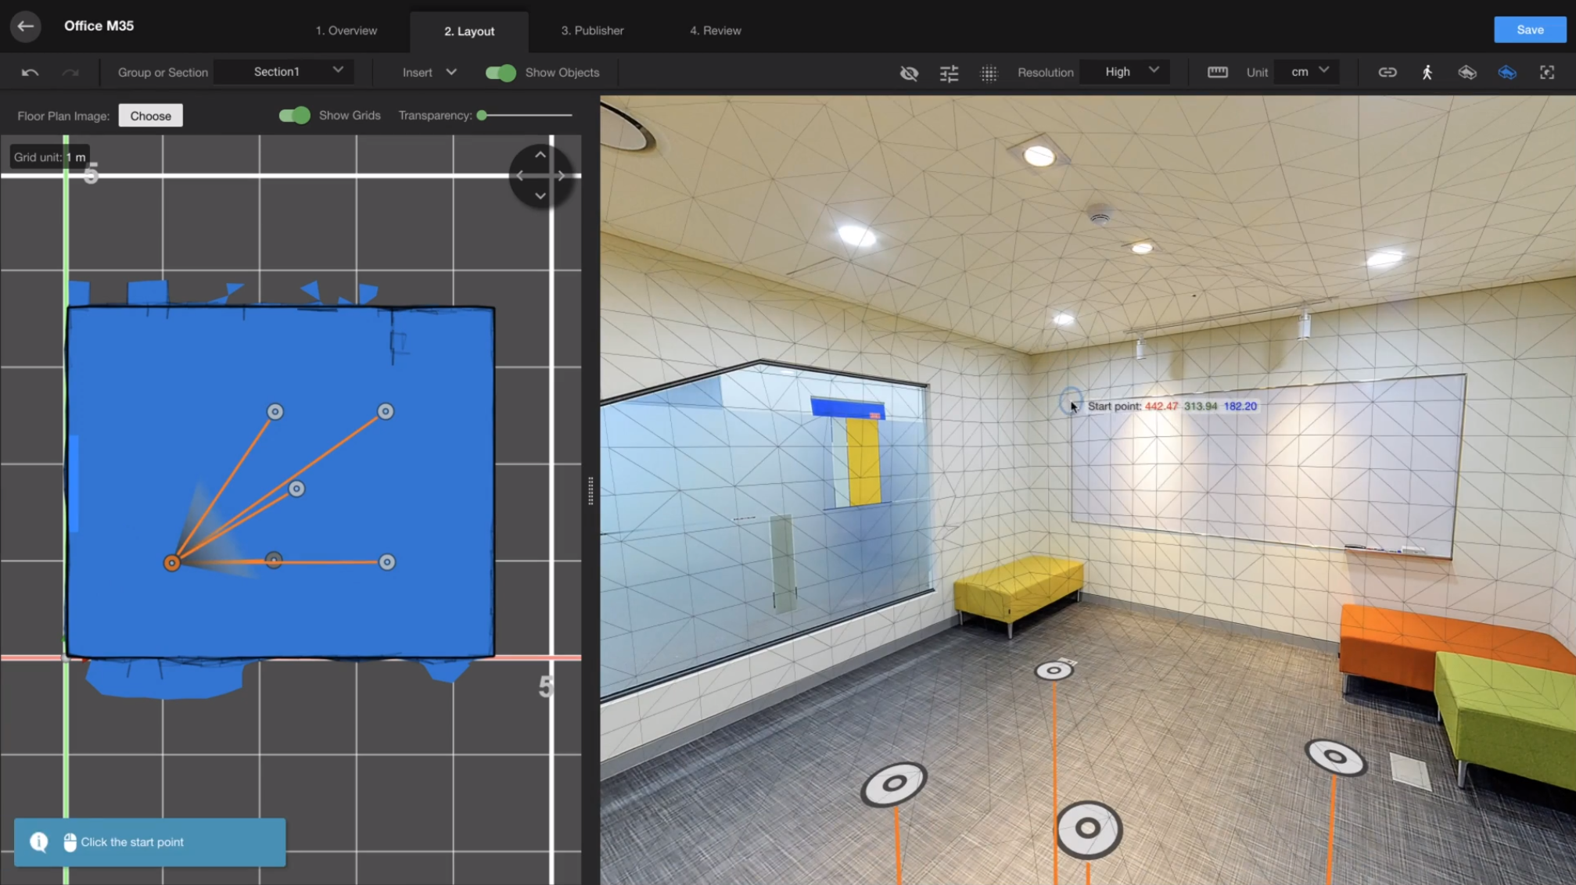
Example: Cupix
https://www.cupix.com/

Slide 5
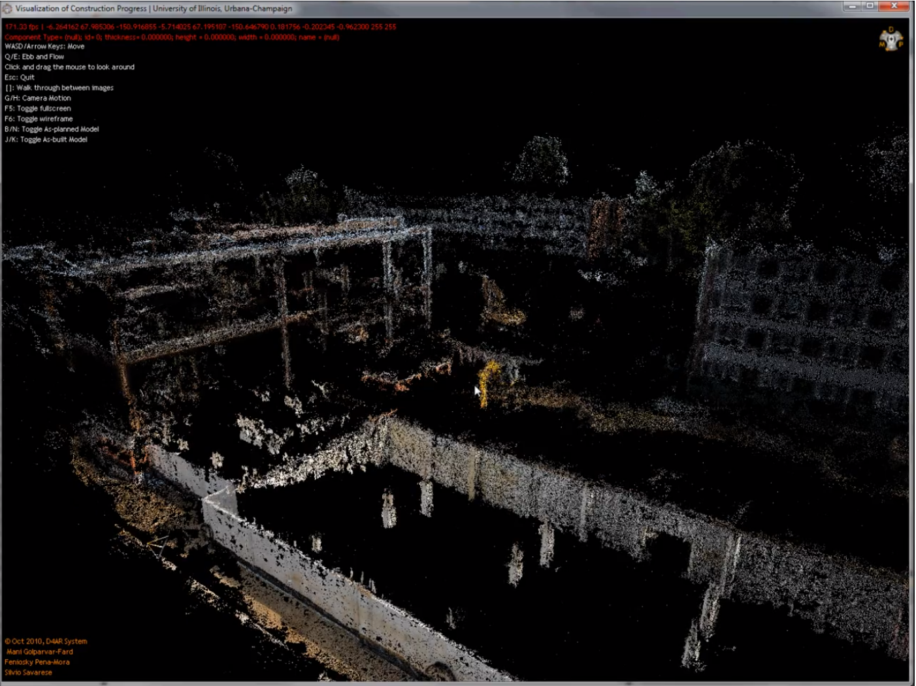
Example: Automated Progress Monitoring Using Images and BIM
http://raamac.cee.illinois.edu/progressmonitoring

Slide 6
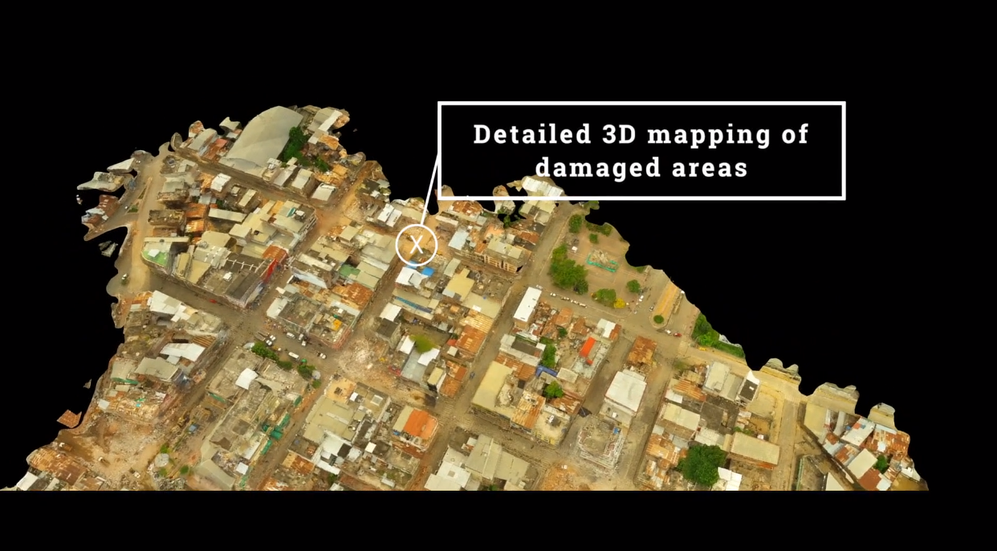
Example: RESCUAV in Globalmedic
https://globalmedic.ca/rescuav/

Slide 7
Projection Matrix
i : Image number
2D point
3D point
If we knew a projective matrix in each image, we can compute the image point corresponding to the world point
If we knew more two image points indicating same world point, we can compute the location of the world point. (triangulation)
Notes:
Go to the visual inspection techniques

Slide 8
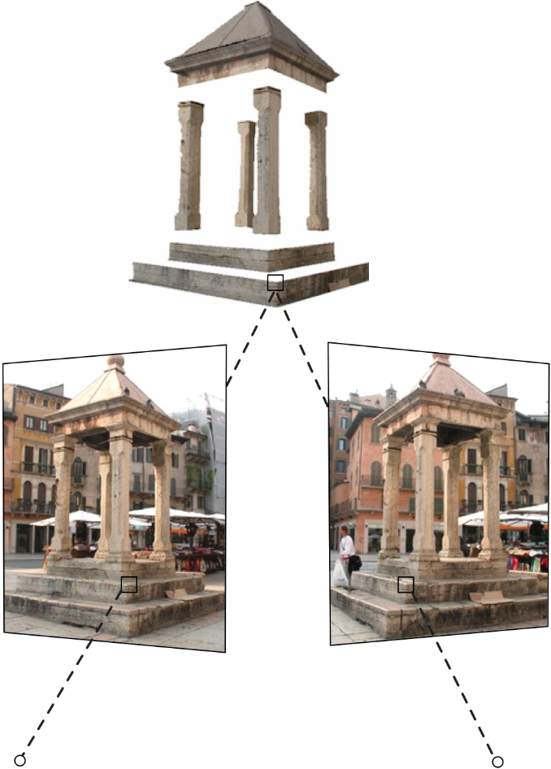
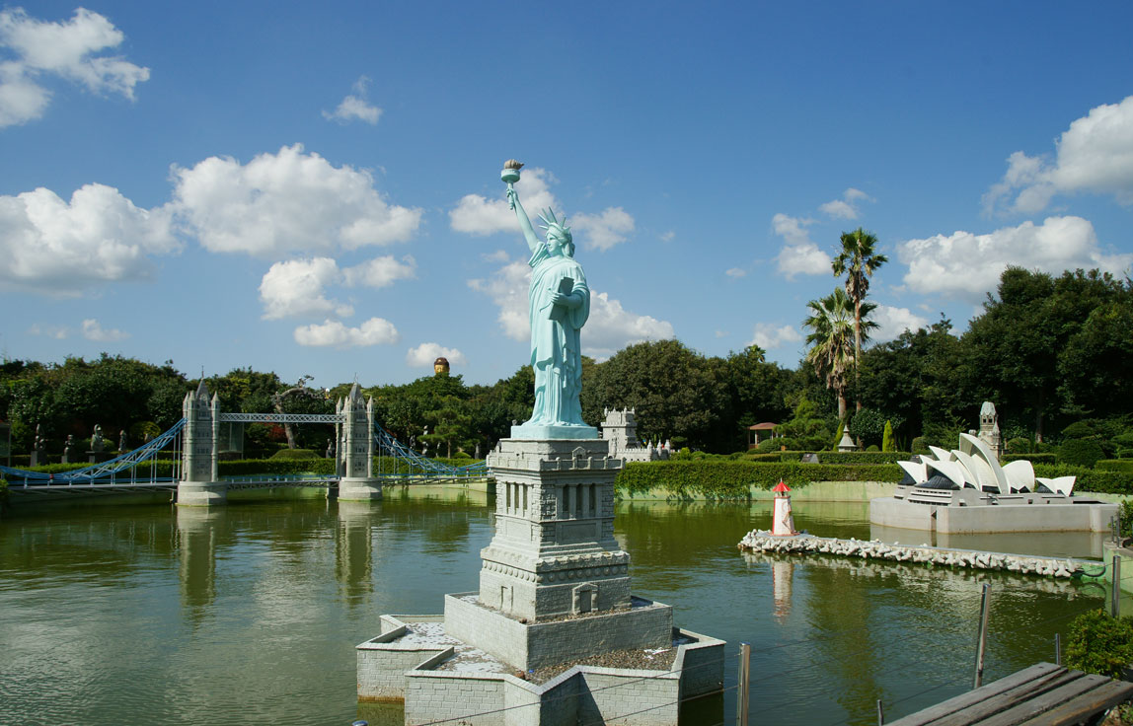
FAQ in Camera (Multi-view) Geometry
Q1. Can we compute a 3D location of a single image point?
Q2. Why do we need to know a camera model? Q3. Can we compute a 2D point on a image if we know 3D points?
Q4. Can we measure a real-distance from images?
Q5. What is the role of GPS data?
3D World
UP TO SCALE
Image 1
Image 2

Slide 9
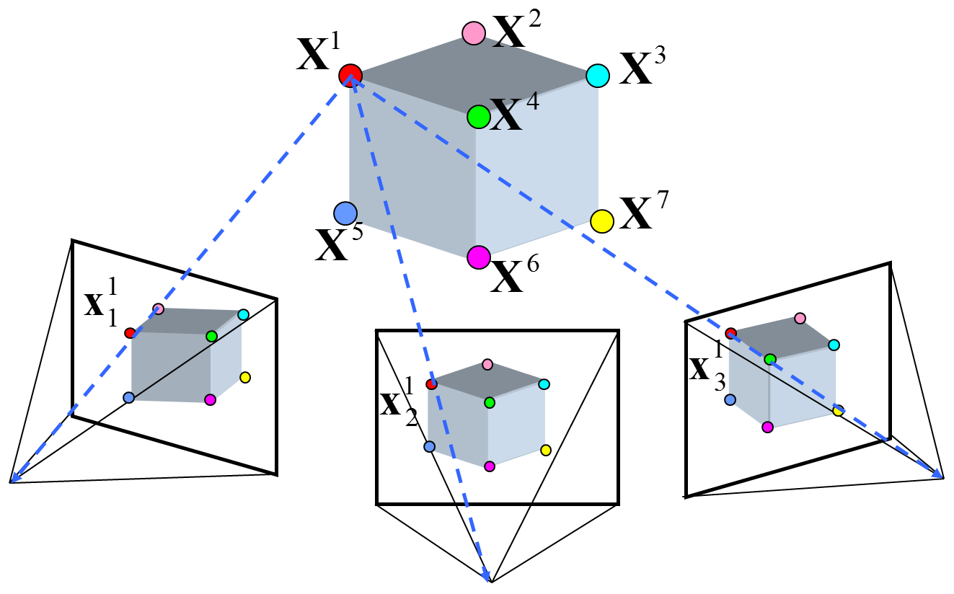
Multiview Geometry (More than Two Images)
World
Robust feature and feature matching make this possible.
P₁
Image 1
Image 3
P₃
Image 2
P₂

Slide 10
Revisit the SfM Problem
Image 1
Image 2
⁞ | ⁞ | ⁞ | ⁞ | ⁞
Image N
⁞
⁞
⁞
⁞
⁞
Robust feature and feature matching make this possible.
Input
Observed 2D image position
Output
Unknown Camera Parameters (with some guess)
Unknown Point 3D coordinate (with some guess)
Notes:
What we knew: 2D points are matched. A single world points are projected on the different images.

Slide 11
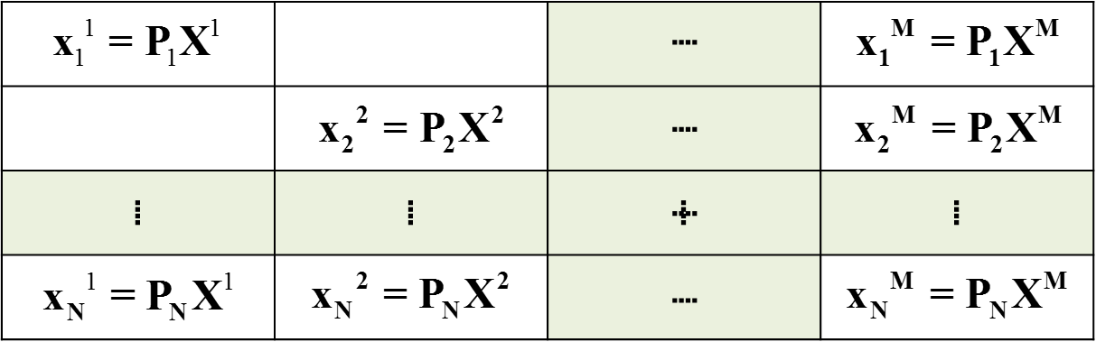
Bundle Adjustment
Observation
Re-projection
=
Features matching
Optimization
problem
A valid solution must let the re-projection close to the observation.
Notes:
What is X ??????

Slide 12
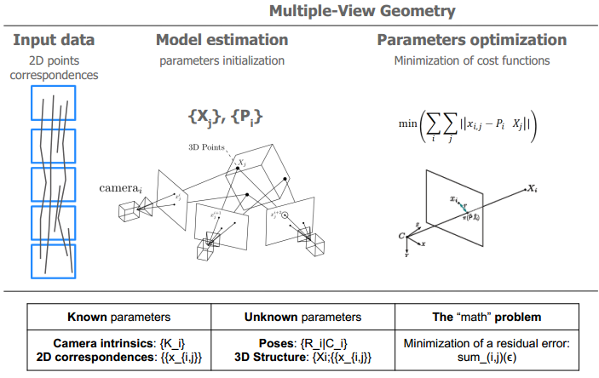
SfM is an Optimization Problem

Slide 13
What Makes This Problem Challenging?
Not enough overlaps across the images
Not enough features on the scene in the world
O(N²) complexity (matching)
Wrong matching

Slide 14
Problem Statement: Image-based Measurement
i : Image number
Input
Input
Output
Obtain the projective matrices from SfM software

Slide 15
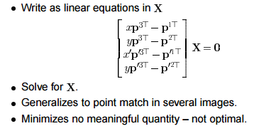
Triangulation Methods (3D Position from 2D Points on Images)
Find a null vector of A when Ax=0

Slide 16
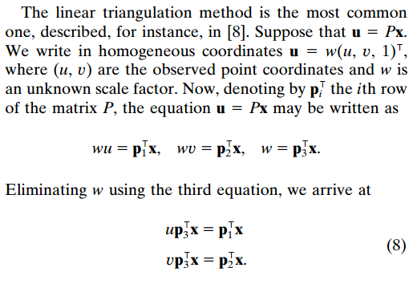
Triangulation Methods (Derivation)
https://perception.inrialpes.fr/Publications/1997/HS97/HartleySturm-cviu97.pdf

Slide 17
Slide Credits and References
Lecture notes: JianXiong Xiao. “Multi-view 3D Reconstruction for Dummies”. Princeton Vision Group
CVPR 2015 Tutorial: SfM Pipelines
http://vision.princeton.edu/courses/SFMedu/
http://cs.brown.edu/courses/cs143/
http://people.csail.mit.edu/torralba/courses/6.869/6.869.computervision.htm
http://www.cs.utexas.edu/~grauman/courses/fall2009/schedule.htm
http://graphics.cs.cmu.edu/courses/15-463/2010_spring/463.html
https://courses.engr.illinois.edu/cee598vsc/sp2015/lecturenotes/
VisualSfM: http://ccwu.me/vsfm/doc.html
Pix4D: https://support.pix4d.com/hc/en-us/sections/200591059-Manual#gsc.tab=0

